Slide 1

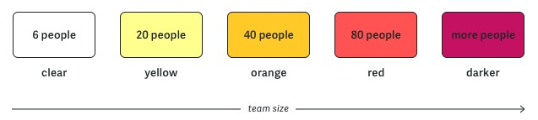
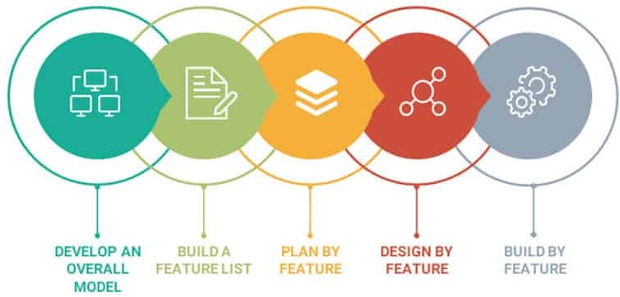
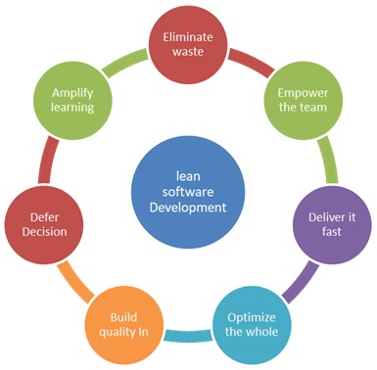
Agile Software Development
Topic: Crystal, FDD & Lean Frameworks
Dr. Nikhil Govil
Associate Professor, Program Coordinator – B.Tech. (CSE), Dept. of CEA

Slide 2

Crystal Framework

Slide 3
Crystal Framework
Alistair Cockburn developed the Crystal method for IBM in 1991.
Crystal focuses on people over processes.
Crystal recognizes that different teams will perform differently depending on team size, criticality and priority of the project.

Slide 4
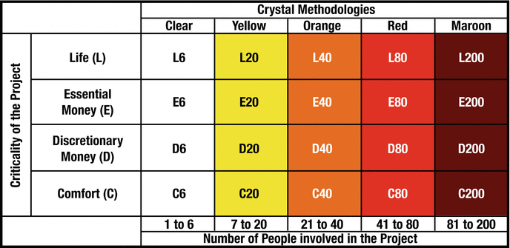
Families of Crystal Methodology
There are five “colors” which represent the five families of Crystal methodologies, which are to be adopted based on the size of the project:
Clear: Up to 6 people
Yellow: Up to 20 people
Orange: Up to 40 people
Red: Up to 80 people
Maroon: Up to 200 people

Slide 5
Key Principles of Crystal Framework
There are seven properties in the Crystal family. The first three are compulsory for all Crystal approaches, but the rest are optional and can be adopted if appropriate:
Frequent delivery
• Reflective improvement
Osmotic (co location) communication
Personal safety
Focus on work
Access to Subject Matter Experts and Users
Technical tools

Slide 6
Advantages of Crystal Framework
Crystal framework advantages include:
Teams communicate directly with each other, reducing management overhead.
The framework can adapt as a team grows or shrinks.

Slide 7
Disadvantages of Crystal Framework
Crystal framework disadvantages include:
Lack of structure can slow down inexperienced teams.
Not clear on how remote teams can share knowledge informally.

Slide 8
Feature Driven Development (FDD) Framework

Slide 9
Feature Driven Development (FDD)
FDD is a client-centric, lightweight Agile framework.
As its name suggests, it organizes software development around making progress on features.
FDD focuses on delivering working software repeatedly in timely manner.

Slide 10
FDD Life cycle
FDD was designed to follow a five-step development process, built largely around discrete “feature” projects.

Slide 11
FDD Life cycle
FDD framework has following five steps:
Develop an overall model
Build a feature list
Plan by feature
Design by feature &
Build by feature.

Slide 12
Advantages of FDD
FDD’s strengths include:
Simple five-step process allows for more rapid development.
Allows larger teams to move products forward with continuous success.

Slide 13
Disadvantages of FDD
FDD’s weaknesses include:
Does not work efficiently for smaller projects.
Highly dependent on lead developers or programmers.

Slide 14
Lean Framework

Slide 15
Lean Software Development
Lean Software Development borrows its philosophy from the Automobile industry (Toyota).
Other manufacturing organizations began using this system, and the name later changed to Lean.
This methodology was first applied to the creation of software in 2003.

Slide 16
Lean Principles
Lean Software Development can be summarized by seven principles as:
Eliminate waste
Amplify learning (Knowledge sharing)
Decide as late as possible
Deliver as fast as possible
Empower the team
Build integrity in (quality)
Optimize the whole system

Slide 17
Advantages of Lean Framework
Lean framework’s strengths include:
Eliminates unnecessary activity, and as a result can reduce costs.
Empowers the development team to make decisions, which can also boost morale.

Slide 18
Disadvantage of Lean Framework
Lean framework’s weaknesses include:
Heavily depends on the team involved, making it not as scalable as other frameworks.
Depends on strong documentation, and failure to do so can result in development mistakes.

Slide 19
References
Ken Schawber & Mike Beedle, Agile Software Development with Scrum, Pearson, 2008.
Robert C. Martin, Agile Software Development, Principles, Patterns and Practices, Prentice Hall,2002.
Lisa Crispin & Janet Gregory, Agile Testing: A Practical Guide for Testers and Agile Teams, Addison Wesley, 2008.
Alistair Cockburn, Agile Software Development: The Cooperative Game, Addison Wesley, 2006.

Slide 20


